Slide 1


Fundamentals of RM
RM System and Process
Leadership in RM
Incident Investigation
RM Tools & Challenges
RM in Industry
People & Org.
Application and Perspectives
On Becoming a
Leader in Risk Management
ENGG404 - Lecture
Chapter 6.10: Professionalism,
Ethics and Equity, Integrity, and Conflict Of Interest

Slide 2

Chapter 6.10: Professionalism, Ethics and Equity, Integrity
“Leading the Way to a Safer World”
https://drive.google.com/open?id=1HbT-vllIsbYmhUBU4TbNzLMtyACmKDo8
Pathway: TeamDrive > ESRM Instruction Team Resources > Video Clips >
52 Ch6.10 Professionalism CCPS Leading the Way to a Safer World.mp4
Center for Chemical Process Safety, a technological community
within the American Institute for Chemical Engineering
00:00 – 02:20
At 2:20, pause and look for familiar firms as the credits roll.
02:21 – 02:45
https://www.youtube.com/watch?v=7xjpUIEwVUM
Note: Although this video may seem centric to chemical engineering, all petrochemical manufacturing industries require and rely on the expertise of all engineering disciplines.
Consider: excavations, foundations and infrastructure, power distribution, waste water treatment, air pollution controls, computer and automatic process controls, networks and information technologies, structures, pressure vessels and piping systems, materials of construction, machines and machinery, instrumentation and electrical systems, chemical process units, resource extraction for raw materials, conversion of raw materials to finished products, logistics and transportation; design, fabrication, construction, start-up, operations, maintenance, financial management, and operations management.
Show this video before class starts.
Chapter 6.10: Professionalism, Ethics and Equity
‹#›
Notes:
‹#›

Slide 3
Learning Outcomes
We will explore the question,
“What does it mean to be an upstanding and
outstanding professional engineer?”
Explain professionalism and assess a situation about professionalism.
Explain ethics, and assess a situation about ethical (and unethical) behaviour:
    Examine and critique a situation where an engineer’s professional ethics, integrity, or professional practice may be called into question, and recommend the best course of action.
    Gauge an organization’s or a leader’s decision-making process on a scale of ethical behaviour.
    Manage apparent contradictions and ambiguities during your career within your organization.
Chapter 6.10: Professionalism, Ethics and Equity
‹#›
Notes:
‹#›

Slide 4
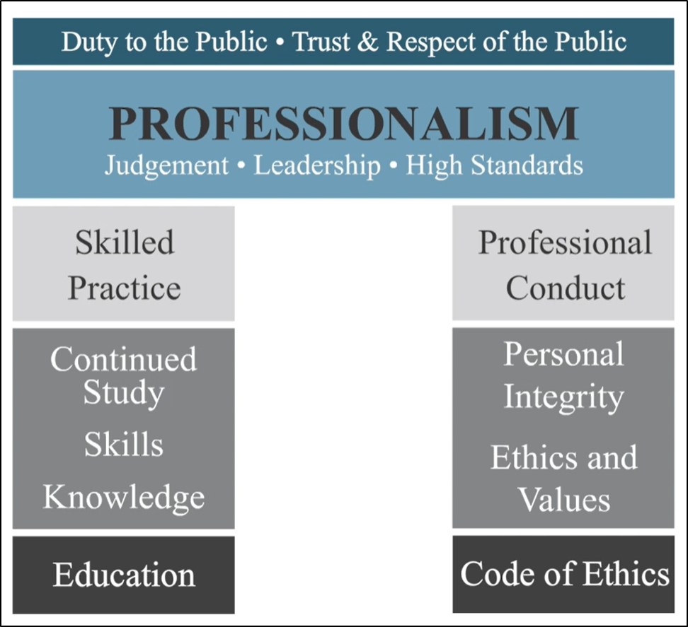
APEGA Mandate is “Duty to the Public”:
See Chapter 6.9
Chapter 6.10: Professionalism, Ethics and Equity
‹#›
Notes:
APEGA Script: There are two pillars on which professionalism is built. The first pillar is skilled practice. Education allows the development of skills and knowledge—that is the foundation for competency. Continued study is imperative to maintain and enhance our knowledge, and to ensure we continue to practise skillfully.
The second pillar is professional conduct. APEGA’s Code of Ethics lays out the professional expectations of licensed professionals. Personal values, ethics, and integrity are key to set the conditions for acceptable professional conduct.
These two pillars—skilled practice and professional conduct—are the core elements to support the behaviour expected by your fellow licensed professionals.
APEGA’s responsibility is to ensure its licensed professionals, members-in-training, and permit holders demonstrate good judgement, provide capable leadership, establish and meet high standards, and fulfil their professional duties.
Success in all of these areas will maintain and strengthen the trust and respect the public has for our professions.

Slide 5
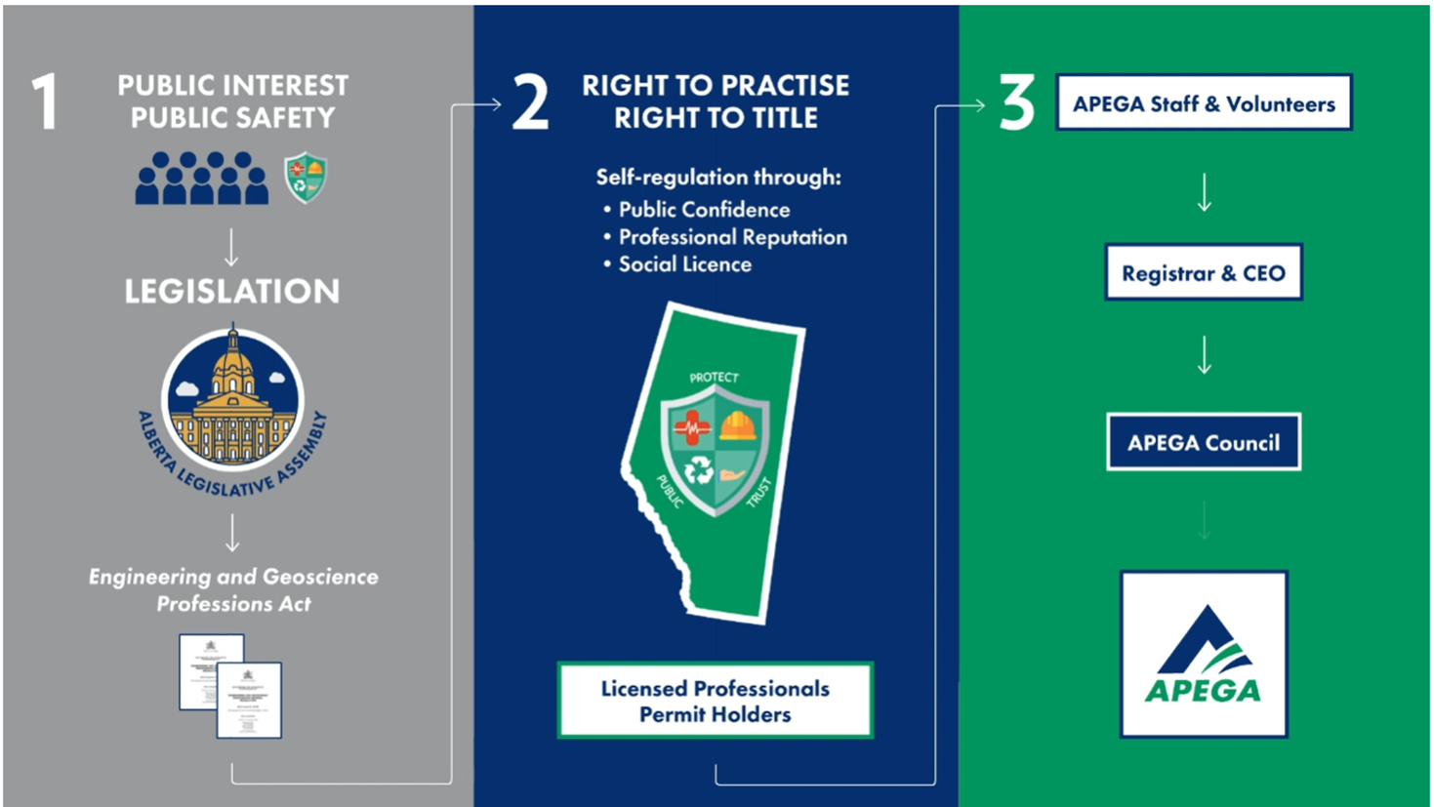
APEGA is Empowered through the EGP Act:
Chapter 6.10: Professionalism, Ethics and Equity
‹#›
Notes:
APEGA Script: The citizens of Alberta trust the Government of Alberta to protect their public interest and safety. Because of this, the government passed the Engineering and Geoscience Professions Act (EGP Act). The EGP Act provides the framework under which engineering and geoscience work is performed, and it establishes APEGA as the body to regulate the professions. There is no consideration for member self-interest written into the EGP Act or the General Regulation.
The EGP Act outlines who and what needs to be regulated, and how APEGA can regulate. APEGA regulates to maintain the public confidence, protecting our professional reputation and the social licence granted to the professions. All licensed professionals and permit holders are regulated, along with the right to practise and the right to title.
An elected council of APEGA licensed professionals and public members is empowered to establish how APEGA regulates under the constraints of the EGP Act. The council selects the Registrar and CEO, who provides APEGA staff and volunteers with support.
This relationship creates a constant feedback loop and support system.

Slide 6
The Practice of Engineering:
Some points about the practice of engineering:
    Technologically complex
    Large contribution to society, and for the benefit of society
    Ethical obligations.
You could be asked to choose one of the first two, and describe in terms relevant to the practice of engineering; however, the CCPS video clearly illustrated these two.
Having said this, you should take an opportunity to reflect on the relevancy of “technologically complex” or “large contribution to society” that involved the organization from your team project.
The third item will be discussed further in this lecture.
Chapter 6.10: Professionalism, Ethics and Equity
‹#›
Notes:
‹#›

Slide 7
Professionalism in Engineering
A profession is a calling that requires:
  Specialized knowledge,
  Intensive preparation,
  High standards of achievement,
  High standards of practice,
  Continued study,
  Ethical conduct, and
  Public service (duty to the public).
  Http://www.apega.ca/pdf/guidelines/professionalism.pdf
As engineering students, you can readily identify with these.
So we will explore this in this topics.
As explained in APEGA Introductory content.
Chapter 6.10: Professionalism, Ethics and Equity
‹#›
Notes:
‹#›

Slide 8
Professionalism in Engineering
Definition:
CCPE defines the “practice of engineering” as:
“the practice of professional engineering means any act of planning, designing, evaluating, advising, reporting, directing or supervising, or managing any of the foregoing, that requires the application of engineering principles, and that concerns the safeguarding of life, health, property, economic interests, the public welfare, or the environment.”
Consider the bold-text words in relation to the BP-DWH Loss Incident. Choose one, and think about some aspect as it relates to the underlying latent cause and related RME.
Think about framing your response as:
<the selected bold-text word>
<latent cause relative to the bold-text word>
<the related risk management system element>
Chapter 6.10: Professionalism, Ethics and Equity
‹#›
Notes:
‹#›

Slide 9
Professionalism in Engineering
Definition:
CCPE defines the “practice of engineering” as:
“the practice of professional engineering means any act of planning, designing, evaluating, advising, reporting, directing or supervising, or managing any of the foregoing, that requires the application of engineering principles, and that concerns the safeguarding of life, health, property, economic interests, the public welfare, or the environment.”
Think about framing your response as:
<the selected bold-text word>
<latent cause relative to the bold-text word>
<the related risk management system element>
An example from BP-DWH:
Directing or Supervising
Although there were many reports about the failures in the BOP, there was insufficient management oversight (direction and supervision) about i) the possible impacts if there was a blow-out that could not be mitigated, and ii) the appropriate actions to restore the BOP to effective operation or to delay “production” (well completion) until restored.
Incident Reporting, Investigation, Analysis, and Actions
Chapter 6.10: Professionalism, Ethics and Equity
‹#›
Notes:
‹#›

Slide 10
Recall: The Role of APEGA
Administers the Engineering, Geological And Geophysical Professions Act Of Alberta
    Self governing: APEGA is empowered by the act to govern its members without oversight or intervention by the provincial government.
    Serves the public interest
    Ensures high standards of practice
    Ensures only properly qualified people are allowed to practice
    Enforceable code of ethics
As professionals, we have a responsibility under the professional engineers act to perform our roles appropriately and ethically.
Chapter 6.10: Professionalism, Ethics and Equity
‹#›
Notes:
‹#›

Slide 11
Revisiting the APEGA Engineering & Geoscience Act
Relevant portions of the Act:
2(1): No individual…except a professional engineer … shall engage in the practice of engineering …
3(2): No individual…except a professional engineer….shall affix the stamp or seal of a professional engineer…or allow that stamp, seal or permit number to be affixed to a plan, drawing, detail drawing, specification or other document…unless:
    (a) that plan, drawing, detail drawing, specification, other document or reproduction was prepared by or under the supervision and control of, and
    (b) the stamp, seal or permit number is affixed with the knowledge and consent or in accordance with the direction of the professional engineer or licensee to whom or the permit holder to which the stamp, seal or permit number was issued.
And the APEGA Code of Ethics…
Chapter 6.10: Professionalism, Ethics and Equity
‹#›
Notes:
‹#›

Slide 12
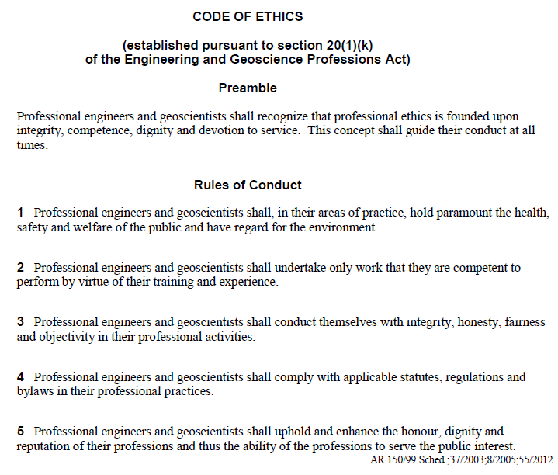
APEGA Code of Ethics – An Excerpt
Engineering
Flixborough
Discuss
APEGA Act,
Provincial Laws
MMA RW LI
Chapter 6.10: Professionalism, Ethics and Equity
‹#›
Notes:
‹#›

Slide 13
Why Professionalism and Ethics in Engineering?
Without due care and diligence, our professionalism and ethics
could be called into question!
    No one wants this to happen in their careers.
Cases of alleged professional misconduct, unethical behaviours, incompetence, negligence, corruption, have lead to investigations and charges against professional engineers.
    Such actions are far from the standards of professionalism, ethics, integrity and avoidance of conflict of interest that the public and our profession demand of its members.
At stake: our reputation, our credibility, our career, and
our ability to work in the profession.
Chapter 6.10: Professionalism, Ethics and Equity
‹#›
Notes:
‹#›

Slide 14
Example: Consider this Case (Actual 2018 Case)
Mr. Smith, a mechanical engineer registered as a Professional Engineer (P.Eng.) in Alberta, allowed permitted documents to be authenticated by an EIT (Engineer in Training). The EIT stated that she had an agreement with Mr. Smith from 2007 to 2017 to apply his “electronic stamp and signature to professional documents” and send numerous structural/civil design plans to a custom home builder without Mr. Smith having to conduct a review.
The Code of Ethics Rules of Conduct that were breached in this case are 1 through 4, and in consideration of both Mr. Smith and the EIT:
Without reviews of the structure by the
P.Eng., the design could be deficient and
could collapse; thus both the P.Eng. and
EIT did not hold paramount public safety.
The mechanical engineer is working on
civil/structural engineering plans, outside
their scope of competency. The EIT
undertook work for which they are
not recognized as being competent.
Both the P.Eng. And the EIT are misleading,
perhaps deceiving the clients that the
documents were authenticated by Mr. Smith,
which they were not.
Neither the P.Eng. nor the EIT complied
with requirements of The Act:
3(2): No individual…except a professional
engineer….shall affix the stamp or seal of a
professional engineer…or allow that stamp…
Code of Ethics states “Professional Engineers shall:
1. in their areas of practice, hold paramount the health, safety and welfare of the public and have regard for the environment.
2. undertake only work that they are competent to perform by virtue of their training and experience.
3. conduct themselves with integrity, honesty, fairness and objectivity in their professional activities.
4. comply with applicable statutes, regulations and bylaws in their professional practices.”
Chapter 6.10: Professionalism, Ethics and Equity
‹#›
Notes:
‹#›

Slide 15
Revisit the Definition of Professional Engineering:
Revisit: “… that concerns the safeguarding of life, health, property, economic interests, the public welfare or the environment”
.. “Safeguarding” means “the protection of”
“Economic interests” means:
The A&P part of PEAP - assets and production / productive capacity
    Business interests
    The funds and resources (including confidential
    information and data) entrusted to us.
Chapter 6.10: Professionalism, Ethics and Equity
‹#›
Notes:
‹#›

Slide 16

Revisit the Definition of Professional Engineering:
The manner in which we manage those resources and the decisions we make concerning those funds are fundamentally based on our values.
Revisit this thought experiment … a lesson in “values”:
“you are walking the down the hall-way …”
Our values drive our decisions!
Chapter 6.10: Professionalism, Ethics and Equity
‹#›
Notes:
‹#›

Slide 17
Areas of Potential Ethical Problems
We may be entrusted with sensitive (confidential, proprietary, private, personal) information that could give an unfair advantage to one party over another.
This unfair advantage could be unethical or illegal!
Our decisions about using that information or decisions based on that information must adhere to our principles and our ethics.
Professionalism, ethics and equity (accountability) means that your decisions as a professional engineer must fall within the meaning of professional engineering.
Chapter 6.10: Professionalism, Ethics and Equity
‹#›
Notes:
‹#›

Slide 18
Example: Areas of Potential Ethical Problems
Case Study:
You are a petroleum engineer working for a well-survey company.
You learn about much higher than expected reserves through a report that comes across your desk.
The client of the well survey company owns this intellectual property, the report.
You recognize that this information is valuable to yourself and/or someone outside of the organization.
Please think about these questions:
What are three possible decisions that you can make?
What decision would (should) you make?
What are the values on which you base those decisions?
Chapter 6.10: Professionalism, Ethics and Equity
‹#›
Notes:
‹#›

Slide 19
Example: Areas of Potential Ethical Problems
Case Study:
You of the are a petroleum engineer working for a well-survey company.
You learn about much higher than expected reserves through a report that comes across your desk.
The client of the well survey company owns this intellectual property, the report.
You recognize that this information is valuable to yourself and/or someone outside organization.
Possible decisions:
  Call your broker to buy stock in the client company.
  Contact a competitor and sell the information.
  Discuss the information only with authorized persons in your company.
The right and only decision:
  Discuss the information only with authorized persons in your company.
Values: Rightful ownership of intellectual property. Client confidentiality and secured IP. Honesty. Integrity. Accountability in your job as an employee.
Chapter 6.10: Professionalism, Ethics and Equity
‹#›
Notes:
‹#›

Slide 20
Ethical Approaches (APEGA):
Ethics is the study of the moral issues and making decisions that confront individuals and organizations i.e. “right and wrong”.
Ethics can be further refined as:
    Virtue ethics – values, internally imposed codes
    Utilitarianism – greatest good for largest number
    Duty ethics – externally imposed codes & laws
    Rights ethics – human rights trump all
    Ethical Egotism – do what is best for you
Chapter 6.10: Professionalism, Ethics and Equity
‹#›
Notes:
‹#›

Slide 21
Our Hierarchy in Applying Our Ethics – Five Discrete Ethics:
As professional engineers, and to one extent or another, most of us apply this “ethics hierarchy” in our decision making using these five discrete ethics:
  I comply with the law.
  (Duty ethics – externally imposed codes & laws)
  I comply with the professional code.
  (Duty ethics – externally imposed codes & laws)
  I protect the public welfare.
  (Utilitarianism – greatest good for largest number)
  I acknowledge the rights of people.
  (Rights ethics – human rights trump all)
  I will not compromise my personal values.
  (Virtue ethics – values, internally imposed codes)
Note: This is a model for applying ethics, and is NOT an exhaustive list.
When we apply our ethics to make a decision, we ask ourselves:
    In what order do our ethics hierarchy occur?
    Which discrete ethics are used or not used? Missing categories?
    What is our personal bottom line?
Chapter 6.10: Professionalism, Ethics and Equity
‹#›
Notes:
‹#›

Slide 22
Example: Our Hierarchy in Applying Our Ethics:
Case Study:
Now consider the ethics that you applied in reaching the right and only decision: “Discuss the information only with authorized persons in your company.”
We applied our ethics as follows (note that not all were applied):
  I comply with the professional code.
  (Duty ethics – externally imposed codes & laws)
  I comply with the law.
  (Duty ethics – externally imposed codes & laws)
  I will not compromise my personal values.
  (Virtue ethics – values, internally imposed codes)
Chapter 6.10: Professionalism, Ethics and Equity
25
Notes:
‹#›

Slide 23
Integrity and Ethical Behaviour:
Two “ideas” about of integrity and ethical conduct:
1) Doing the right thing at the right time.
  This is very easy to do if it is a positive or a pleasant choice.
  It is not easy to do when it is not positive, nor pleasant, nor popular.
2) Doing the right thing at the right time when nobody is watching.
Consider these questions:
Have you ever been in a situation where your integrity
or your ethics were challenged? (Hint: What was the situation?)
If so, what was it? (Hint: What was the issue with that situation?)
How did you manage it? (Hint: What did you do in that situation?)
Chapter 6.10: Professionalism, Ethics and Equity
‹#›
Notes:
‹#›

Slide 24
Integrity and Ethical Behaviour:
Two “ideas” about of integrity and ethical conduct:
1) Doing the right thing at the right time.
  This is very easy to do if it is a positive or a pleasant choice.
  It is not easy to do when it is not positive, nor pleasant, nor popular.
2) Doing the right thing at the right time when nobody is watching.
The situation: The regional Investigations and Enforcement Branch of the provincial Ministry of the Environment calls on your plant with a search warrant. You and your supervisor are tasked with aiding the search.
The issue: You find a “compromising document”, and both of you realize it can be harmful to the company.
Possible decisions:
What are some possible decisions?
What are the unethical, ethical, and legal decisions?
Chapter 6.10: Professionalism, Ethics and Equity
‹#›
Notes:
‹#›

Slide 25
Integrity and Ethical Behaviour:
Two “ideas” about of integrity and ethical conduct:
1) Doing the right thing at the right time.
  This is very easy to do if it is a positive or a pleasant choice.
  It is not easy to do when it is not positive, nor pleasant, nor popular.
2) Doing the right thing at the right time when nobody is watching.
The situation: The regional IEB of the MoE calls on your plant …
The issue: You find a “compromising document”, and both of you realize it can be harmful to the company.
Possible decisions:
Destroy the document.
Replace the document for their discovery.
Give the document to the investigators.
Which of the above possible decisions is: Unethical? Ethical? Legal?
Chapter 6.10: Professionalism, Ethics and Equity
‹#›
Notes:
‹#›

Slide 26
Integrity and Ethical Behaviour:
Two “ideas” about of integrity and ethical conduct:
1) Doing the right thing at the right time.
  This is very easy to do if it is a positive or a pleasant choice.
  It is not easy to do when it is not positive, nor pleasant, nor popular.
2) Doing the right thing at the right time when nobody is watching.
The situation: The regional IEB of the MoE calls on your plant …
The issue: You find a “compromising document”, and both of you realize it can be harmful to the company.
Possible decisions:
Destroy the document. Unethical, possibly illegal!
Replace the document for their discovery. Ethical AND legal.
Give the document to the investigators. Ethical or unethical?
From your employer’s perspective, this is certainly contrary to your employer’s interests, and therefore they may consider it unethical.
Chapter 6.10: Professionalism, Ethics and Equity
‹#›
Notes:
‹#›

Slide 27
Ethical Behaviour & the Decision-Making Process:
Consider applying ethics in the span of decision making:
Unethical Ethical
Collusion … Coercion … Co-option … Co-operation … Collaboration
On ideas expressed By Mark Flint, P.Eng., Former CEO APEGA
Q: As professionals, where must we be?
We must strive to be at the green end – cooperation and collaboration!
Usually most teams are at co-operation. Certainly collaboration is most desirable. We coach for this and teams strive for this.
Chapter 6.10: Professionalism, Ethics and Equity
‹#›
Notes:
‹#›

Slide 28
Integrity and Ethical Behaviour:
Two “ideas” about of integrity and ethical conduct:
1) Doing the right thing at the right time.
  This is very easy to do if it is a positive or a pleasant choice.
  It is not easy to do when it is not positive, nor pleasant, nor popular.
2) Doing the right thing at the right time when nobody is watching.
The situation: The regional regional IEB of the MoE calls on your plant …
The issue: You find a “compromising document”, and both of you realize it can be harmful to the company.
Possible decisions:
Destroy the document. Unethical, possibly illegal! Collusion.
Replace the document for their discovery. Ethical AND legal. Cooperation
(you and your supervisor; the company and the IEB.
Give the document to the investigators.
Chapter 6.10: Professionalism, Ethics and Equity
‹#›
Notes:
‹#›

Slide 29
Integrity and Ethical Behaviour
Two “ideas” about of integrity and ethical conduct:
1) Doing the right thing at the right time.
2) Doing the right thing at the right time when nobody is watching.
Both, indeed, are ideal and challenging; however, the latter can be more challenging because it presents an opportunity to make an unethical decisions, or a decision lacking integrity.
Given the previous situation: The IEB of the MoE calls on your plant …
The issue: You find a “compromising document”, but suppose you were by yourself when you found it?
The Challenge: You might be tempted to destroy the document and no one would ever know … but if it ever came to light, your actions were unethical and possibly illegal.
The Lesson in all of this: Never do anything unethical!
Chapter 6.10: Professionalism, Ethics and Equity
‹#›
Notes:
‹#›

Slide 30
The Dilemma: Uphold Ethical Conduct or Acquiesce?
Challenges in your career:
Pressure created by conflicting values.
Temptation to benefit.
Will you:
Uphold: Will you have the courage to make the right ethical decision
when there is pressure to compromise?
OR
Acquiesce: Will you give in to pressure or temptation?
Q: How will you assess such an ethical challenge?
A: By applying the principles reviewed!
Chapter 6.10: Professionalism, Ethics and Equity
‹#›
Notes:
‹#›

Slide 31
The Dilemma: Uphold Ethical Conduct or Acquiesce?
You may be able to discuss an ethical challenge
you have faced already.
Consider these questions in regard to your personal work experience or team project:
  What is the situation?
  What is the issue with that situation in terms relative to ethical conduct?
  What are your possible decisions; identify as ethical or unethical?
  What did you do (or what should you have done), again, in terms relative to ethical conduct?
  What was (or would have been) the final result or outcome (as it pertains to the person / persons / organization making the decision) and state two discrete ethics that were applied? (Although more than 2 may have applied, you need only state two.)
You should be prepared to discuss your ethical challenge relative to your work experience or your team project loss incident …
Chapter 6.10: Professionalism, Ethics and Equity
‹#›
Notes:
‹#›

Slide 32
Example: Apply Integrity and Ethical Behaviour:
The situation: The regional Investigations and Enforcement Branch
of the provincial Ministry of the Environment calls on your plant with a
search warrant. You and your supervisor are tasked with aiding
the search.
The issue: You find a “compromising document” in a filing cabinet, and both of you realize it can be harmful to the company.
Possible decisions (state at least two, no more than three, and identify as ethical or unethical):
Destroy the document. Unethical.
Replace the document for their discovery. Ethical.
Give the document to the investigators. Can be either ethical or unethical – depends on how the employer views this action.
Your Decision:
Replace the document for their discovery.
Outcome (state an outcome and two discrete ethics that were applied):
The company and the employees did not collude in any attempt to hide or destroy the document. The employees complied with the law and upheld professional ethics.
Chapter 6.10: Professionalism, Ethics and Equity
‹#›
Notes:
‹#›

Slide 33
Predicament: Manage Apparent Contradictions & Ambiguities?
The predicament: how will you manage apparent
contradictions and ambiguities in your new workplace?
Your situation: you are a new graduate ...
Your predicament:
    Actions of the organization seem to contradict the values of the organization, or
    Organizational values seem to contradict your sound set of risk management principles and values.
Please think about your predicament.
What are three possible decisions you could make?
What do you need to consider in making a decision as to what to do?
Chapter 6.10: Professionalism, Ethics and Equity
‹#›
Notes:
‹#›

Slide 34
Predicament: Manage Apparent Contradictions & Ambiguities?
What do you do?
Three possible choices:
Degrade your values?
Leave the organization?
Undertake initiative?
We implore you … do not degrade your values!
If and when you degrade or compromise your values, you may allow such things as condoning unacceptable behaviours, or you may be motivated to meet objectives that could put PEAP at risk; ultimately this could result in a significant loss incident.
Chapter 6.10: Professionalism, Ethics and Equity
‹#›
Notes:
‹#›

Slide 35
Predicament: Manage Apparent Contradictions & Ambiguities?
So, two choices remain:
Degrade your values?
Leave the organization?
Undertake initiative?
For b) and c), it ultimately depends on your position in your career,
your scope of responsibility, and your level of influence.
New graduate, newly hired, early in your career:
Can you influence your small organization, your area of responsibility, your circle of influence? Will it make a difference? Do you feel up to the challenge? If so, undertake initiative.
If none of these, then an acceptable decision is to leave the organization. This is neither a wrong nor less than desirable decision.
Chapter 6.10: Professionalism, Ethics and Equity
‹#›
Notes:
‹#›

Slide 36
Predicament: Manage Apparent Contradictions & Ambiguities?
So, two choices remain:
Degrade your values?
Leave the organization?
Undertake initiative?
Fast-forward … a highly competent leader in risk management:
How will you respond in your future role as a competent leader?
You have the ability to influence change within your area of responsibility. It depends on:
a) your willingness to take on the challenge and
b) any other factors that may support or hinder your success.
      Are you being set up for success?
  If factors support, undertake initiative.
  Are you being set up for failure?
  If factors are barriers to success, leave the organization.
The final decision is ultimately a personal decision, and what is the best fit for you in your career and your personal life.
Chapter 6.10: Professionalism, Ethics and Equity
‹#›
Notes:
‹#›

Slide 37
Example Predicament: Manage Apparent Contradictions & Ambiguities
Your situation:
Soon after graduating … you are a new hire
Fast-forward … you are a highly competent leader
Your predicament:
Actions of the organization seem to contradict the values of the organization, or
Organizational values seem to contradict your sound set of risk management principles and values.
You need to make a decision:
Leave the organization?
Undertake initiative?
What factors do you need to consider in making your decision?
Both personal factors and professional factors such as:
Pay; personal life-style (work-life balance); support within the organization (peers, supervisor, person you replace); motivation; confidence of others and in yourself; career advancement, etc.
Chapter 6.10: Professionalism, Ethics and Equity
‹#›
Notes:
‹#›

Slide 38
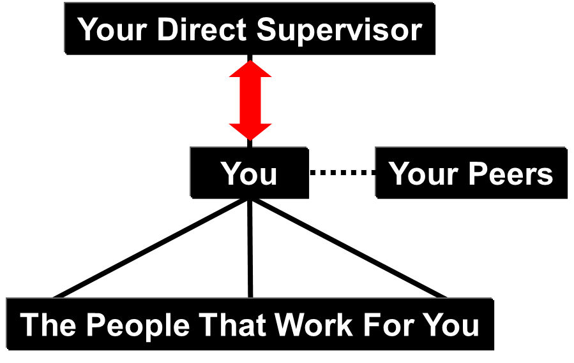
Ex: Dilemma: Work with Your Organization or Whistle-blow?
Case Study - The Dilemma:
You are on a project, and you observe that due to time constraints for the project, an intermediate engineer is allowed to provide road design drawings to the contractor without senior review and approval.
This action appears in clear conflict with professional requirements and legal requirements.
What do you do?
Recall the discussion on the relationship
between you and your supervisor:
Thus, seek clarity from within your organization!
    Your first step should be to work with your supervisor and within the organization – it could be a misunderstanding or miscommunication.
    Your second step should be to work with and within your organization’s corporate policies to resolve the issue.
Chapter 6.10: Professionalism, Ethics and Equity
‹#›
Notes:
‹#›

Slide 39
Ex: Dilemma: Work with Your Organization or Whistle-blow?
What do you do? (continued)
  Your third step: Go external from your organization:
Ultimately, if you cannot resolve the apparent conflict, you may be motivated to seek external avenues of inquiry (government authorities and regulators, professional associations) as a last resort ...
This action is termed “whistle-blowing”.
This is not a trivial action.
The process calls into question the integrity and ethics of the organization under scrutiny and of the whistle-blower.
Personal motivators may come into question:
is it a grudge or an honest concern?
Chapter 6.10: Professionalism, Ethics and Equity
‹#›
Notes:
‹#›

Slide 40
Summary and Key Points:
Challenges, Dilemmas, Predicaments:
You may find yourself in a challenging or compromising situation:
    Unskilled practice in engineering,
    Unprofessional conduct,
    Unethical behaviours,
    Betray values of honesty, privilege and confidentialities,
    Conflict of interest,
    Corruption.
If you give your decision options careful thought, make the ethical decision based on the appropriate set of positive values, on the hierarchy of five discrete ethics, check with others, and act on your values accordingly, …
… then you can manage yourself through obstacles like these with little difficulty and gain the admiration and respect of your fellow workers.
Chapter 6.10: Professionalism, Ethics and Equity
‹#›
Notes:
‹#›

Slide 41
Summary and Key Points:
You may be presented with a situation where your professional conduct or professional practice may be called into question.
To avoid this, you need to assess that situation, apply the hierarchy of ethics, and recommend the best course of action.
An organization’s or a leader’s decision-making process can be gauged on a scale of ethical behaviour.
Apparent contradictions and ambiguities need to be managed during your career within your organization.
Our professionalism spans beyond our technical competencies, and includes ethical conduct, integrity, and public service (duty to the public).
Our moral compass as professionals is grounded in our hierarchy for applying ethics [1) I comply with the law. 2) I comply with the professional code. 3) etc.] in our making decisions.
If you are questioning whether the pending action (decision and/or behaviour) is ethical, and you cannot resolve that question, then ask for help to discuss and review the ethics of that decision.
Chapter 6.10: Professionalism, Ethics and Equity
‹#›
Notes:
‹#›

